Slide 1
Employee Data Analysis using Excel
STUDENT NAME: DHARSHINI M
REGISTER NO: F30252900D6A29592CA447831EBDB6BA,122201813
DEPARTMENT: B.COM(CORPORATE SECRETARYSHIP)
COLLEGE: MEENAKSHI COLLEGE FOR WOMEN

Slide 2
PROJECT TITLE
Employee Performance Analysis Based On Department and FTE using Excel

Slide 3


AGENDA
Problem Statement
Project Overview
End Users
Our Solution and Proposition
Dataset Description
Modelling Approach
Results and Discussion
Conclusion
3/21/2024 Annual Review

Slide 4

PROBLEM STATEMENT Analyzing employees department, and full-time FTE day analysis helps organizations plan their workforce, allocate resources, and assess productivity. It enables optimal staffing, cost control, and departmental efficiency . By examining FTE days, organizations can identify areas for improvement and drive productivity.

Slide 5

PROJECT OVERVIEW
Developed an Excel-based project to analyze employee data on departmental distribution, and full-time equivalent (FTE) days. This project will provide insights into workforce planning, resource allocation, and productivity assessment. The deliverable will be a comprehensive Excel dashboard with data visualizations and reports to support strategic decision-making.

Slide 6

WHO ARE THE END USERS? 1.HR Managers 2.Department Heads 3.Operations Managers 4. Finance Managers 5. Business Analysts 6. Management Consultants 7. Organizational Development Specialists 8. Workforce Planning Analysts 9. Talent Management Specialists 10. Strategic Planning Teams

Slide 7

OUR SOLUTION AND ITS VALUE PROPOSITION Delimiter – Split the location column Pivot Table – Summary of department and FTE Analysis Graph – Data Visualization

Slide 8
Dataset Description Employee Data Set – Naan Mudhalvan Portal 9 Features Employee ID – Alphabetical (General) Name – Alphabetical (General) Gender – Alphabetical (General) Department - Alphabetical (General) Salary – Numerical FTE – Numerical Employee Type - Alphabetical (General) Work Location - Alphabetical (General) 2 Features used – Department and FTE

Slide 9

THE "WOW" IN OUR SOLUTION Power Pivot Dynamic Dashboards Data Visualization
3/21/2024 Annual Review
9

Slide 10
MODELLING
Step -1 Download The Employee Dataset And Open The Employee Dataset In Excel.
Step -2 Select The Entire Data And Click On Data And Click On Filter Option.
Step -3 Filter Ftp From A To Z Order.
Step -4 Select The Entire Data And Click On Insert And Click On Pivot Table To Create Pivot Table.
Step -5 Drag The Needed Data And Create A Pivot Table.
Step -6 Select The Pivot Table And Click On Insert.
Step-7 Now Click On The Chart That You Want.
Step -8 The Chart Is Created.
10

Slide 11
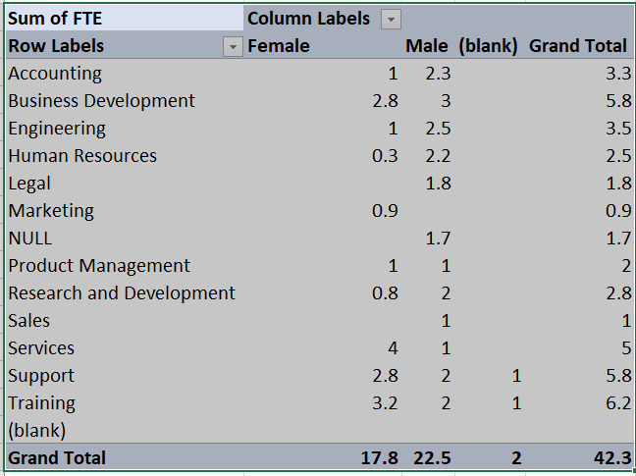
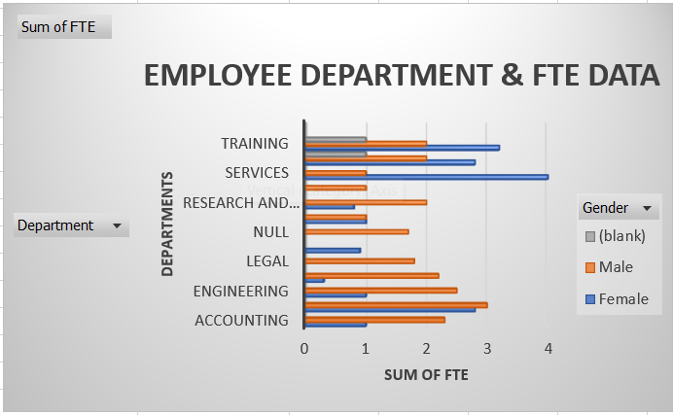
RESULTS
11

Slide 12
Conclusion This Employee Department and FTE Analysis Excel Project provides a comprehensive and user-friendly solution for optimizing workforce planning, resource allocation, and productivity assessment. By leveraging advanced Excel features and data visualization, this project delivers actionable insights and drives data-driven decisions to enhance organizational efficiency and effectiveness.

